Slide 1

POST COVID LIFE: Long Term Impacts on Society, Health & Behavior
A Quantitative & Qualitative Survey-Based Analysis
Presented By:
Amna Arshad
Hooriya Sohail
Mahnoor Asmat
Tayyaba Sohail
Presented To:
Miss Ramsha Khalid

Slide 2











POST COVID LIFE: Long Term Impacts on Society, Health & Behavior
Presented By:
Amna Arshad
Hooriya Sohail
Mahnoor Asmat
Tayyab Sohail
Presented To:
Miss Ramsha Khalid
AGENDA
Study Goal
Demographics
Financial Impact
Physical & Mental Health
Post-Covid Lifestyle
Introduction
Conclusion
Behavioral / Societal Shifts
Government Response

Slide 3
POST COVID LIFE: Long Term Impacts on Society, Health & Behavior
Presented By:
Amna Arshad
Hooriya Sohail
Mahnoor Asmat
Tayyab Sohail
Presented To:
Miss Ramsha Khalid
Study Goal
Financial Impact
Introduction
Government Response
Introduction
COVID-19 changed society permanently
Focus shifted from immediately danger to long-term effects
Need for data, not assumptions.
AGENDA
Physical & Mental Health
Demographics
Behavioral / Societal Shifts
Conclusion
Post-Covid Lifestyle

Slide 4




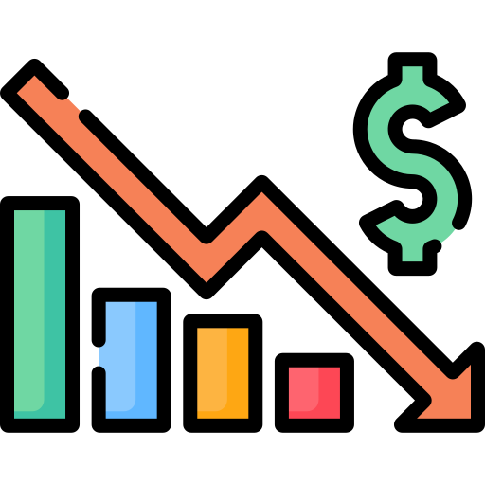






Study Goal
Financial Impact
Government Response
Introduction
AGENDA
Physical & Mental Health
Demographics
Behavioral / Societal Shifts
Conclusion
Post-Covid Lifestyle
Study Objective
Introduction
Covid-19 changed society permanently
Focus shifted from immediately danger to long-term effects
Need for data, not assumptions.
Outbreak
Global Spread
Lockdown
Increasing Death Rates
Economic Crisis
Vaccine Production
Recovery
Outbreak
Global Spread
Lockdown
Increasing Death Rates
Economic Crisis
Vaccine Production
Recovery
Outbreak
Global Spread
Lockdown
Increasing Death Rates
Economic Crisis
Vaccine Production
Recovery
Outbreak
Global Spread
Lockdown
Increasing Death Rates
Economic Crisis
Vaccine Production
Recovery
Measure lasting changes in lifestyle
Work, economy, & mental health
Social behavior & habits
Government response perception

Slide 5



Methodologies
Study Objective
Measure lasting changes in lifestyle
Work, economy, & mental health
Social behavior & habits
Government response perception

Slide 6
Study Objective
Measure lasting changes in lifestyle
Work, economy, & mental health
Social behavior & habits
Government response perception
Methodologies

Slide 7
Study Objective
Measure lasting changes in lifestyle
Work, economy, & mental health
Social behavior & habits
Government response perception
Methodologies

Slide 8
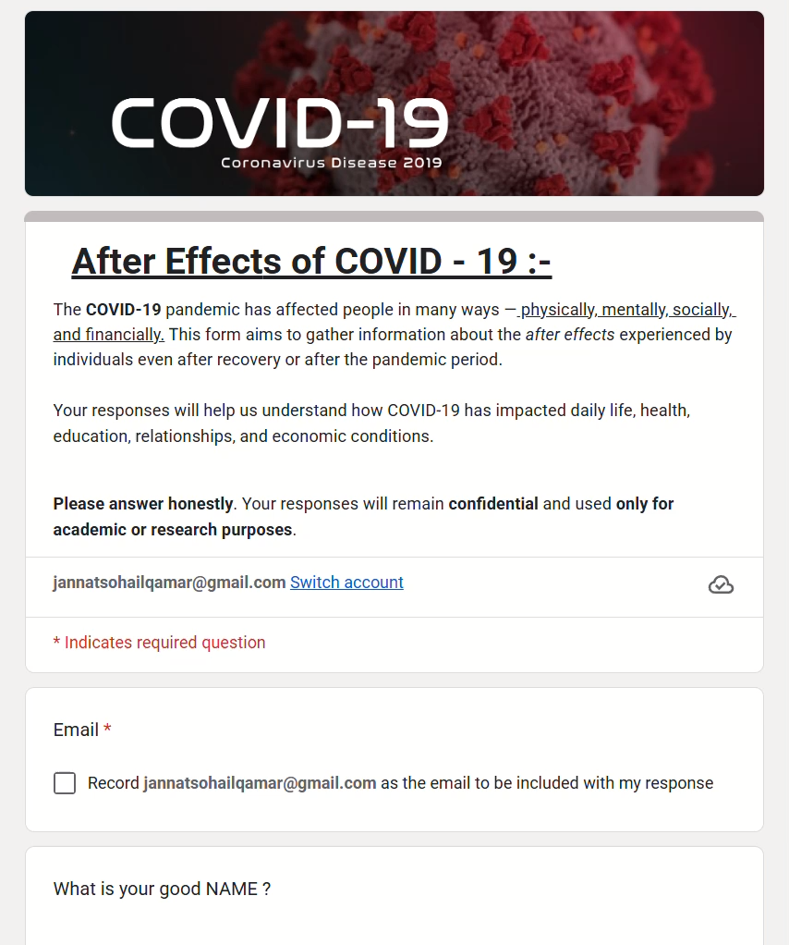
Methodologies
Google Forms
Data Collection

Slide 9
Study Objective
Measure lasting changes in lifestyle
Work, economy, & mental health
Social behavior & habits
Government response perception
Methodologies
Google Forms
Data Collection

Slide 10
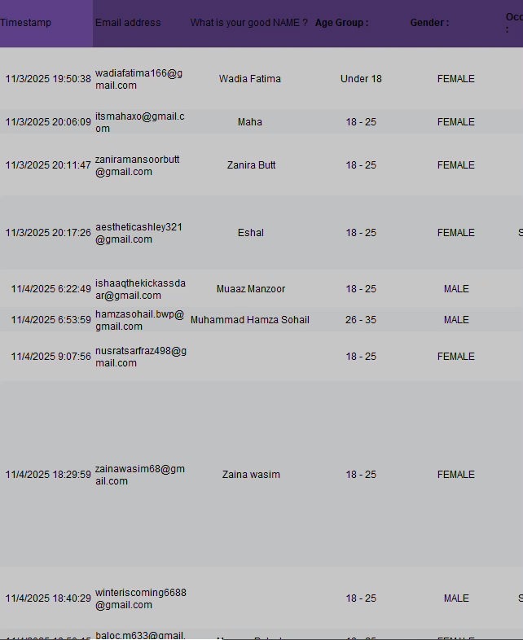
Methodologies
Google Forms
Data Collection
Microsoft Excel
Analysis

Slide 11
Methodologies
Google Forms
Data Collection
Microsoft Excel
Analysis
Analysis

Slide 12
Methodologies
Microsoft Excel
Google Forms
Data Collection
Analysis
Analysis

Slide 13
Google Forms
Microsoft Excel
Data Collection
Analysis
Methodologies
Google Forms

Slide 14
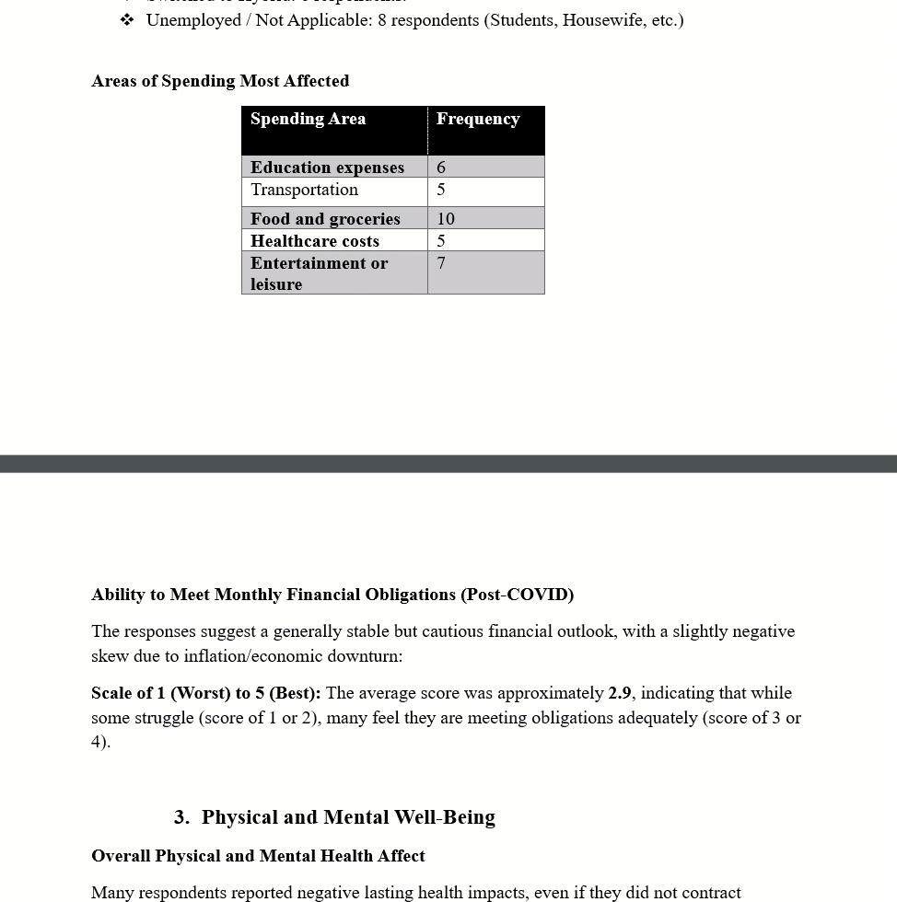
Google Forms
Microsoft Excel
Data Collection
Analysis
Microsoft Word
Report

Slide 15
Google Forms
Microsoft Excel
Microsoft Word
Data Collection
Analysis
Report

Slide 16
Google Forms
Microsoft Excel
Microsoft Word
Data Collection
Analysis
Report

Slide 17

Demographic Insights
Google Forms
Microsoft Excel
Microsoft Word
Data Collection
Analysis
Report

Slide 18

Demographic Insights
Google Forms
Microsoft Excel
Microsoft Word
Data Collection
Analysis
Report

Slide 19
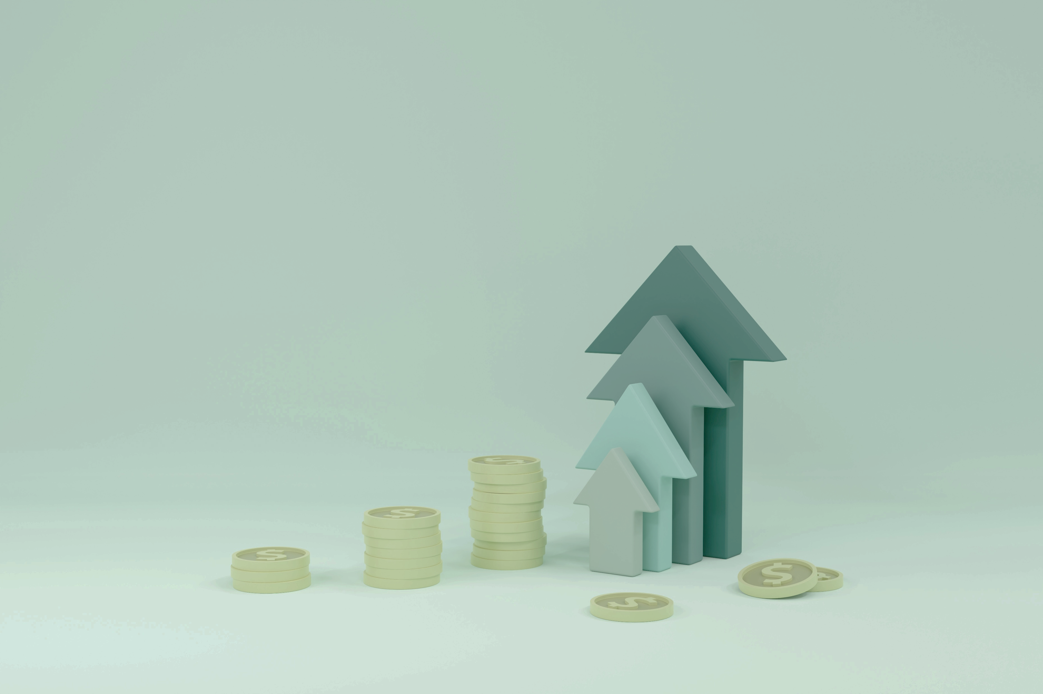
Demographic Insights
Financial Impacts
Google Forms
Microsoft Excel
Microsoft Word
Average rating for financial stability (2.9/5)
Remote, hybrid work rise
Spending shifts
Moderate post-COVID stability
Data Collection
Analysis
Report

Slide 20
Work & Financial Impacts
Demographic Insights
Health Impacts
Physical Health:
Fatigue
Weak immunity
Inconsistent exercise habits
“A lot as mentally i am still before the time covid happened and aged me as if a decade passed physically “
Mental Health:
Stress
Anxiety
Satisfaction score (2.7/5)
“I never contracted COVID but Pandemic has affected my career progress adversely due to which I am still unemployed and hence in severe depression “
Google Forms
Microsoft Excel
Microsoft Word
Average rating for financial stability (2.9/5)
Remote(3 votes), hybrid work rise(6 votes)
Spending shifts (Food and Grocery (10), Entertainment (7), Health costs (6))
Moderate post-COVID stability
Data Collection
Analysis
Report

Slide 21
Financial Impacts
Demographic Insights
Google Forms
Microsoft Excel
Microsoft Word
Average rating for financial stability (2.9/5)
Remote, hybrid work rise
Spending shifts
Moderate post-COVID stability
Data Collection
Analysis
Report
Health Impacts
Physical Health:
Fatigue
Weak immunity
Inconsistent exercise habits
“A lot as mentally i am still before the time covid happened and aged me as if a decade passed physically “
Mental Health:
Stress
Anxiety
Satisfaction score (2.7/5)
“I never contracted COVID but Pandemic has affected my career progress adversely due to which I am still unemployed and hence in severe depression “

Slide 22

Behavioral & Lifestyle changes
Health Impacts
Physical Health:
Fatigue
Weak immunity
Inconsistent exercise habits
“A lot as mentally i am still before the time covid happened and aged me as if a decade passed physically “
Mental Health:
Stress
Anxiety
Satisfaction score (2.7/5)
“I never contracted COVID but Pandemic has affected my career progress adversely due to which I am still unemployed and hence in severe depression “
“In my opinion, although seemingly the world has become much closer due to social media, but it is all one-dimensional. The more people connect throughout social media, the less they do in real life.”

Slide 23

Behavioral & Lifestyle changes
Health Impacts
Physical Health:
Fatigue
Weak immunity
Inconsistent exercise habits
“A lot as mentally i am still before the time covid happened and aged me as if a decade passed physically “
Mental Health:
Stress
Anxiety
Satisfaction score (2.7/5)
“I never contracted COVID but Pandemic has affected my career progress adversely due to which I am still unemployed and hence in severe depression “
“In my opinion, although seemingly the world has become much closer due to social media, but it is all one-dimensional. The more people connect throughout social media, the less they do in real life.”
Government Response

Slide 24
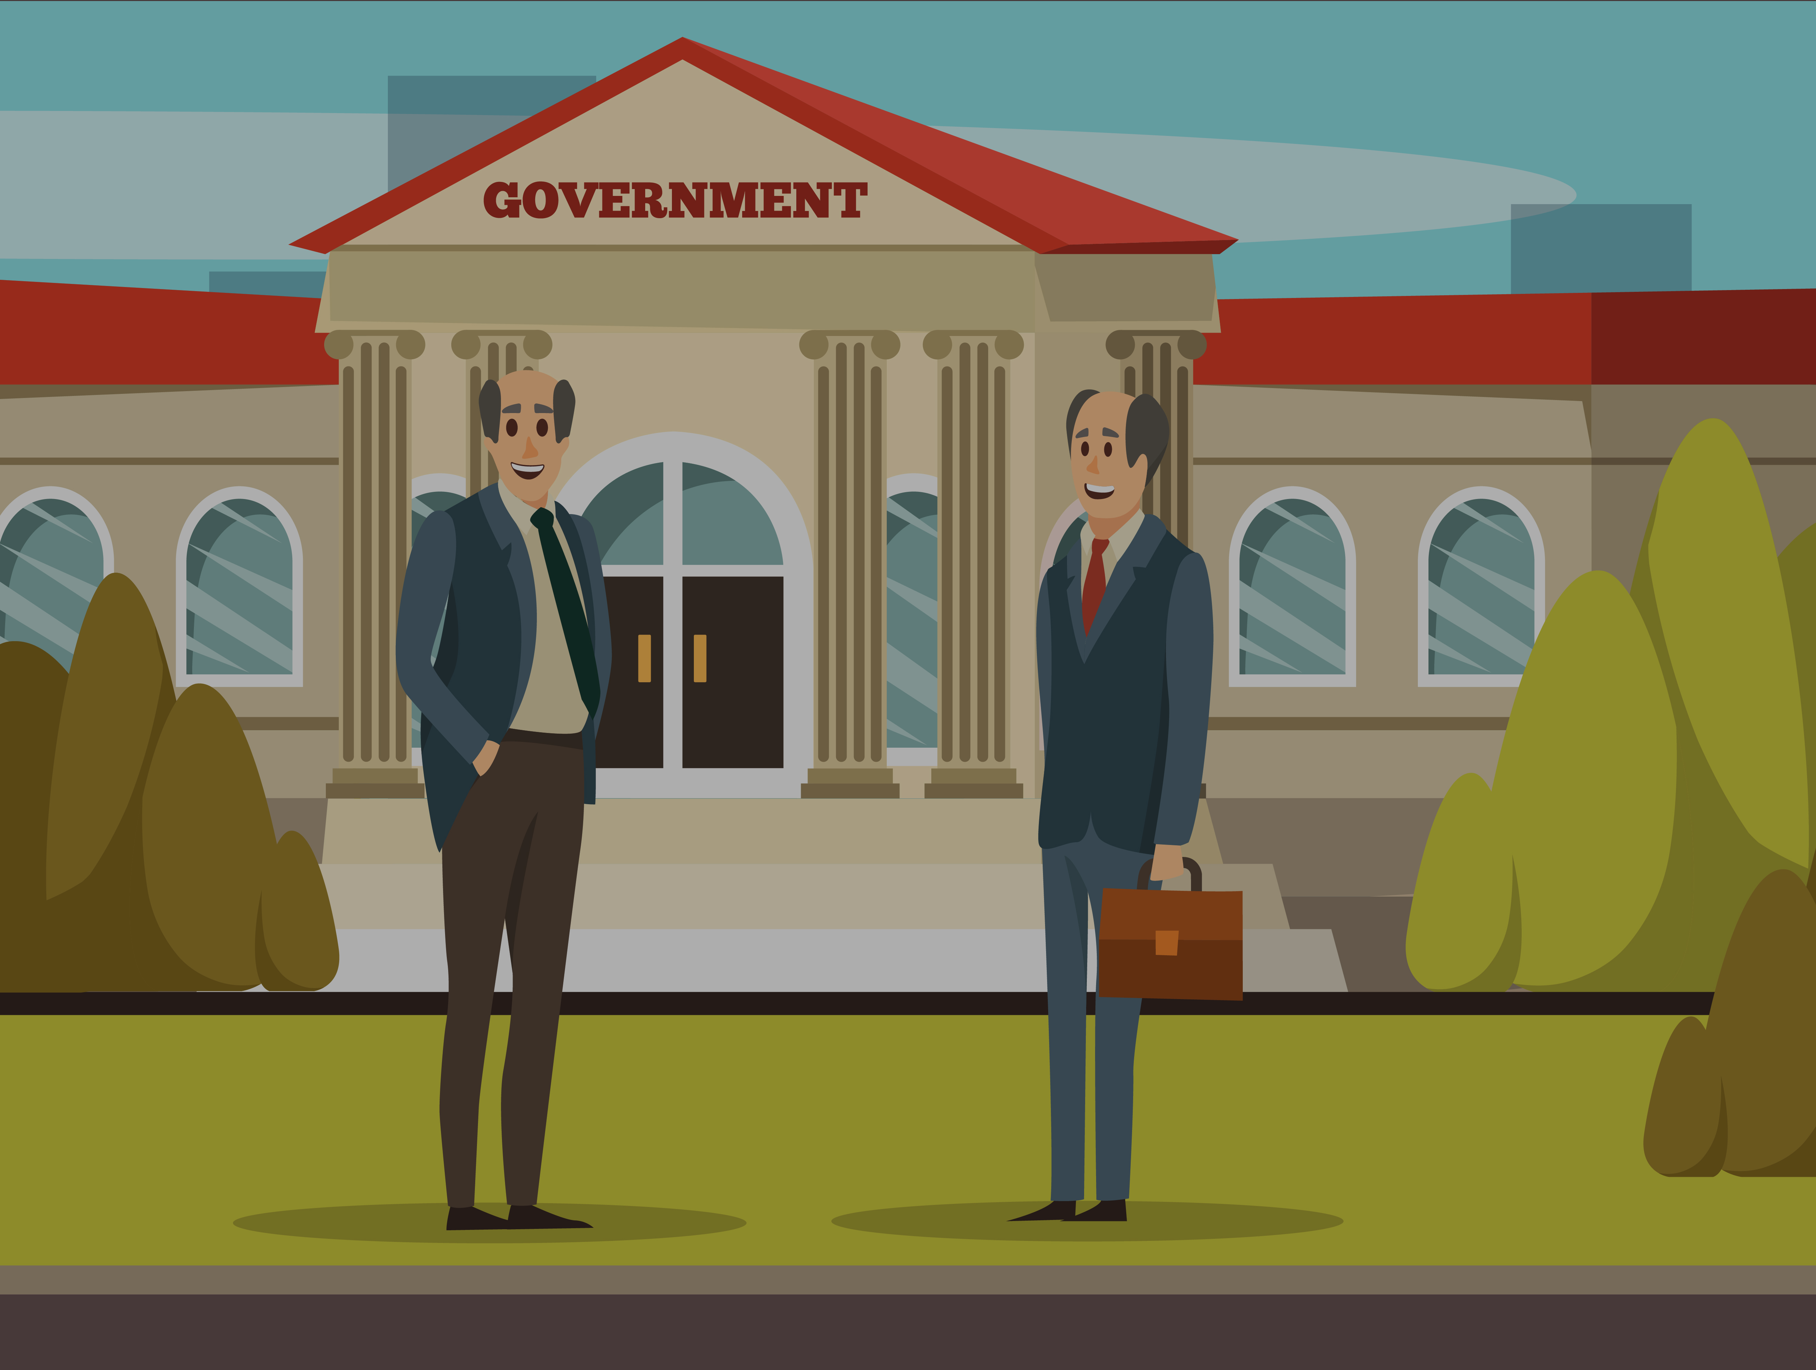

Behavioral & Lifestyle changes
Health Impacts
Physical Health:
Fatigue
Weak immunity
Inconsistent exercise habits
“A lot as mentally i am still before the time covid happened and aged me as if a decade passed physically “
Mental Health:
Stress
Anxiety
Satisfaction score (2.7/5)
“I never contracted COVID but Pandemic has affected my career progress adversely due to which I am still unemployed and hence in severe depression “
Government Response
Strengths
Lockdowns
Vaccination
Management
Weaknesses
Weak Healthcare
Inconsistent SOPs
Limited financial help

Slide 25

Conclusion
Government Response
Covid-19 has left marks that shall never fade away
From the results of the study, we can conclude that:
People have not recovered financially (2.9 Average Score out of 5)
Professional lives have been permanently altered (Unemployment & Hybrid work arangememts)
Mental and Physical health has suffered adverse effects
Behaviors have had both positive and negative effects
Overall, we can say that we all suffer from the trauma the pandemic has left us.
Strengths
Weaknesses
Lockdowns
Weak Healthcare
Vaccination
Inconsistent SOPs
Management
Limited financial help

Slide 26
Government Response
Strengths
Weaknesses
Lockdowns
Weak Healthcare
Vaccination
Inconsistent SOPs
Management
Limited financial help
Conclusion
Covid-19 has left marks that shall never fade away
From the results of the study, we can conclude that:
People have not recovered financially (2.9 Average Score out of 5)
Professional lives have been permanently altered (Unemployment & Hybrid work arangements)
Mental and Physical health has suffered adverse effects
Behaviors have had both positive and negative effects
Overall, we can say that we all suffer from the trauma the pandemic has left us.
THANKYOU !

Slide 27
Conclusion
Government Response
Covid-19 has left marks that shall never fade away
From the results of the study, we can conclude that:
People have not recovered financially (2.9 Average Score out of 5)
Professional lives have been permanently altered (Unemployment & Hybrid work arangememts)
Mental and Physical health has suffered adverse effects
Behaviors have had both positive and negative effects
Overall, we can say that we all suffer from the trauma the pandemic has left us.
Strengths
Weaknesses
Lockdowns
Weak Healthcare
Vaccination
Inconsistent SOPs
Management
Limited financial help
THANKYOU !

